Slide 1
What is Essential? Teaching with Leverage In Mind!

Slide 2
Key Questions
Standards
Which ones do I teach?
Which ones are most important?
Which ones are least important?
Which ones create the most leverage?
Which ones are most ESSENTIAL?
What does ESSENTIAL mean?
OR

Slide 3
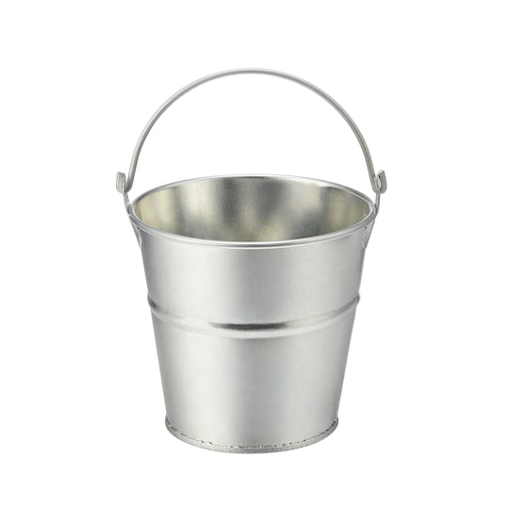
Don’t kick the bucket!

Slide 4
Priority Standards
We will fix it
I will fix it
Drip will fix it

Slide 5
Elementary Leverage/Priority Standards
www.lickingpd.weebly.com

Slide 6
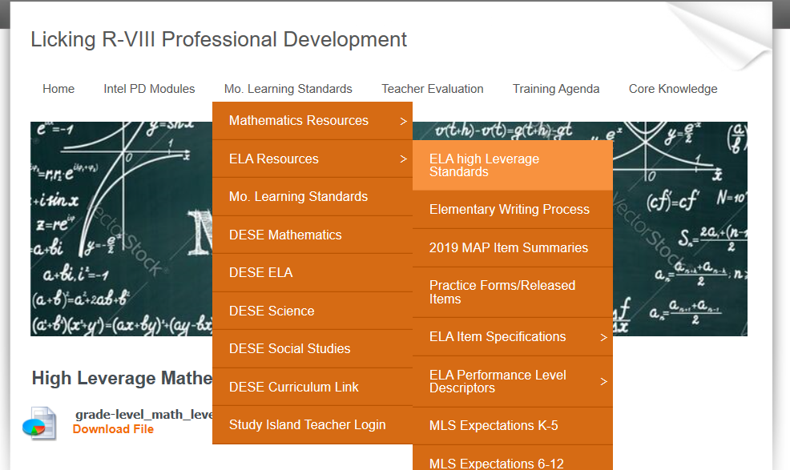
Elementary Leverage/Priority Standards
www.lickingpd.weebly.com

Slide 7
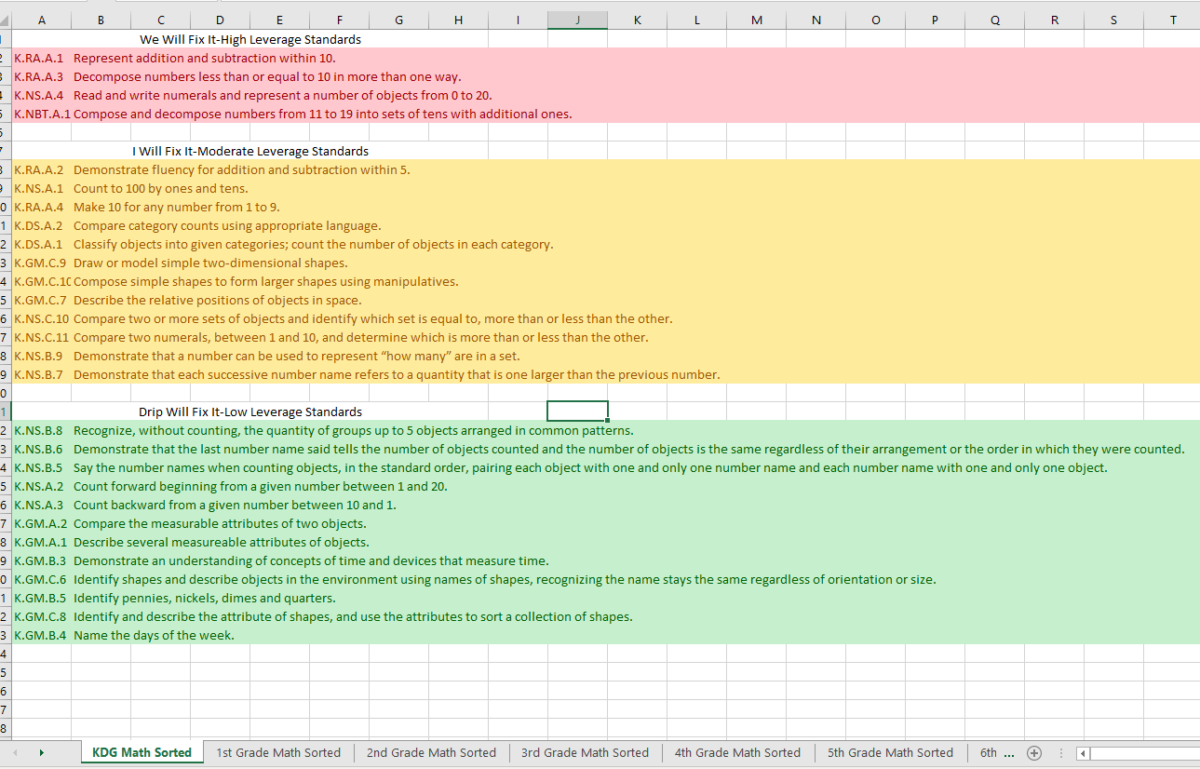

Slide 8
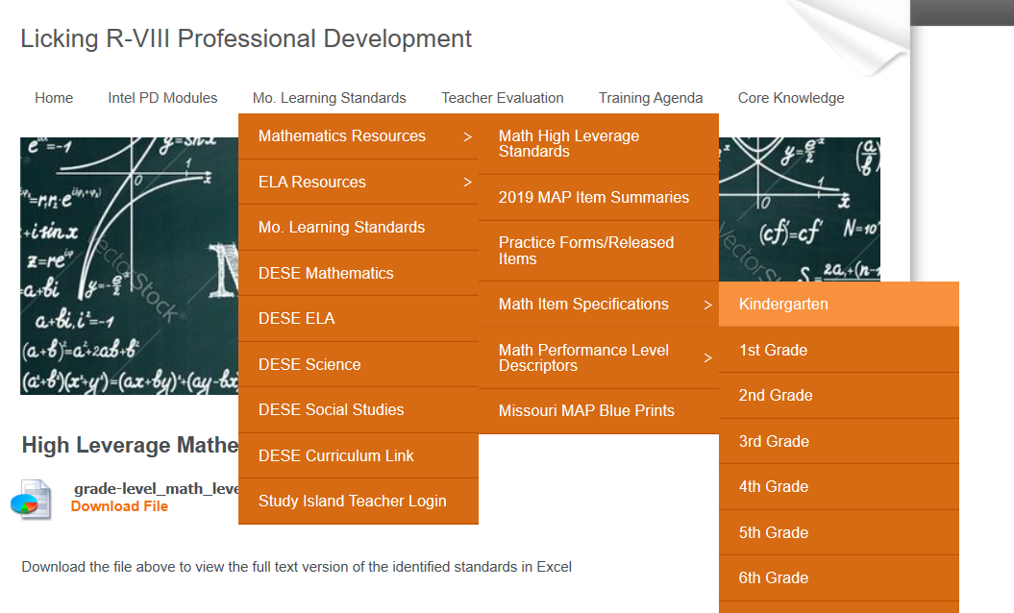
Resources Utilized

Slide 9
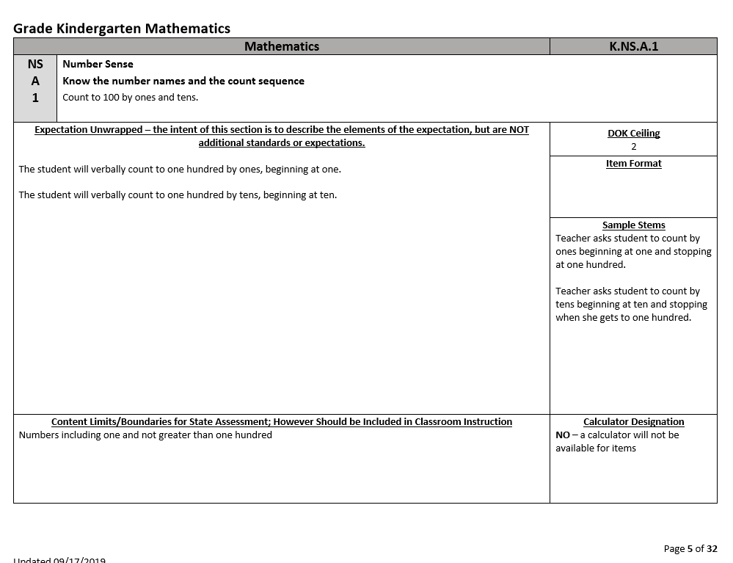

Slide 11
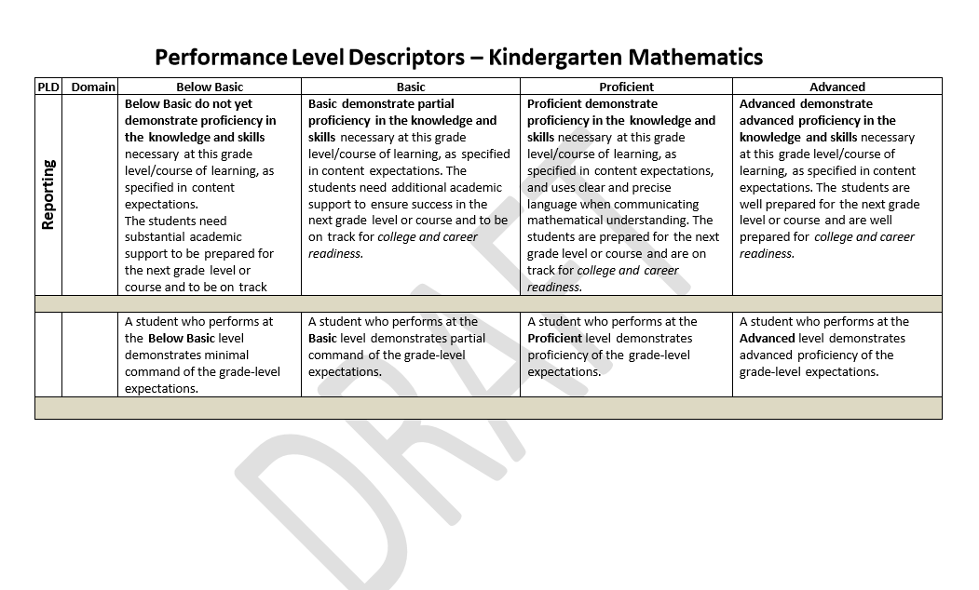

Slide 13
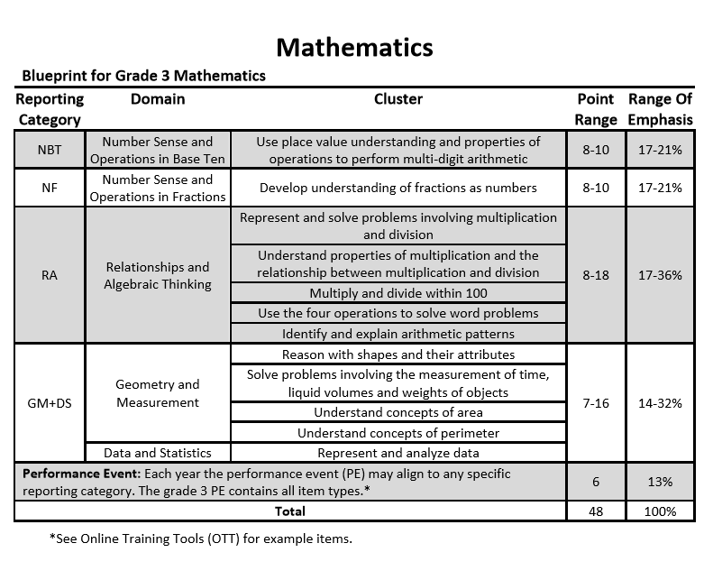

Slide 14
Mastery vs no mastery
What is mastery?
What determines what we will do when mastery does not occur?
70-80% Mastery for the Class
Top Two Tiers (We will fix it & I will fix it)
Common Formative Assessments
(CFA’s)
& Interventions

Slide 15
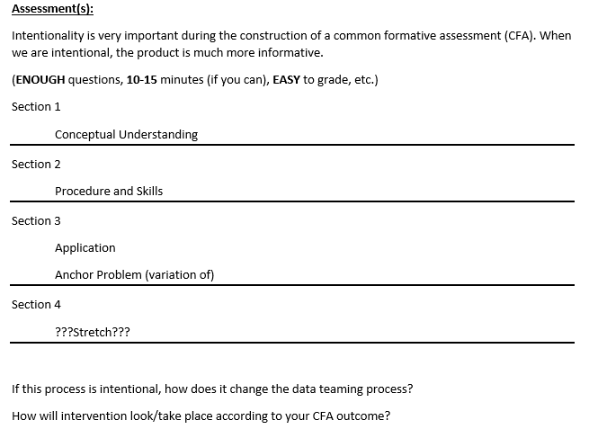
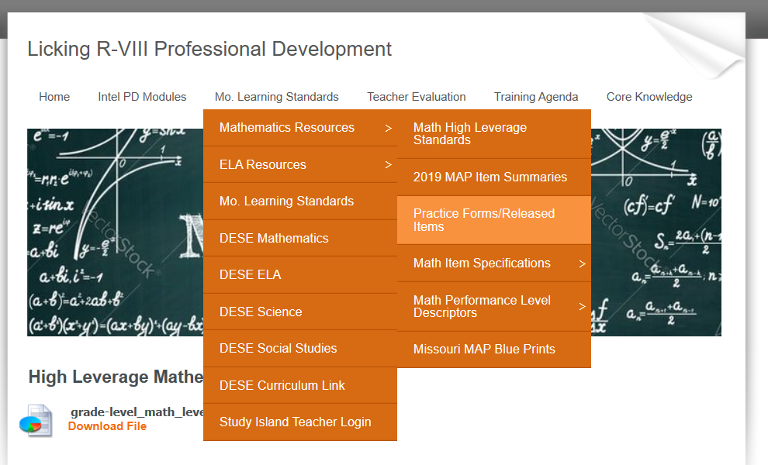
Common Formative Assessments
See Example

Slide 16
We teach all the standards
We assess the top two tiers
How do we assess? CFA’s
How much time do we assess our students (now)?
How much time do we leave for instruction?
Therefore, how long does the assessments (CFA) need to be? ENOUGH

Slide 17
Now What?
We Data Team the Results & Make Decisions
Data Teaming Questions
What do I (we) notice?
What do I (we) wonder?
What do the kids know?
What do the kids not know?
What do we need to change? (Prior to utilizing the assessment again, i.e. assessment-questions, instruction, etc.)
If intentionality was used during the
development of the CFA, students
will already be designated to
specific tiers
(Data Teaming Process and CFA Procedures developed by HMB Systems)

