Slide 1
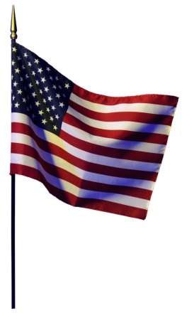
Weber
Bus 10
Licking R-VIII School District
Bus Route # and Drivers
2015-2016
Dixon
Bus 22
Huff
Bus 16
Driver | Bus Number | Color
Jackie Bever | #14 | Green
Isobel McConnel | #12 | Purple
Jim Taylor | #20 | Gold
Brad Robertson | #6 | Orange
James Maddox | #4 | White
Mickey Wilson | #18 | Blue
Tony Huff | #16 | Red
Jamie Vankirk | #11 | Yellow
Samantha Weber | #10 | Black
Norman Dixon | #22 | Silver
Vankirk
Bus 11
Maddox
Bus 4
Wilson
Bus 18
J. Taylor
Bus 20
RobertsonBus 6
Bever
Bus 14
McConnel
Bus 12
Front

